Slide 1
Gray Code Kernels for Optical Flow
CV project - MSc. Computer Science – University of Genoa 20-21
Gian Paolo Bernardini

Slide 2
Introduction
In this activity the main goal was to extract gray-code kernels from video frames and perform a matching procedure between adjacent projections in order to estimate the optical flow.

Slide 3
Why GCKs could be a good in motion-related video tasks
Filtering is a fundamental step for several Computer Vision tasks
Time and memory efficiency (filtering scheme used in real-time scenarios, suitable for mobile applications)
Particularly suited for natural images
Nota a piè di pagina

Slide 4
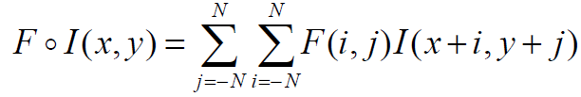

2D discrete spatial convolution
Image I of size WxH
Convolution kernel F of size kxk
Operations per pixel:
Spatial Convolution: O(k^2) - O(k)
FFT convolution: O(log(k))
GCKs convolution: O(1)

Slide 5
Gray-Code Kernels
Gray-Code Kernels are a family of filters that can be used for an efficient filtering scheme. Successive convolution of an image requires only two operations per pixel, regardless of size or dimension of the filter.
Nota a piè di pagina

Slide 6
Gray-Code Kernels
If we have two kernels b1 and b2 and we want to filter an image with these two kernels, first, we calculate with a convolution the result of application of b1 to the image, then the filtering with b2 could be obtained using only 2 summations per pixel, getting partial result from the filtering with the kernel b1, so cutting extensively the spatial and temporal costs. With this type of kernel the operations per pixel will have constant complexity.
Nota a piè di pagina

Slide 7
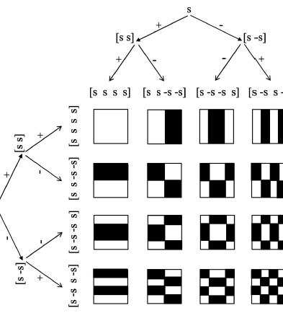
Efficient filtering scheme
Created recursively with a binary tree
Efficiency depends on the ordering in which they are applied to an image
The optimal ordering is linked to the definition of α-index

Slide 8
Gray-Code Kernels
These kernels are created with a binary tree and their efficiency depends on the order with which they are applied to an image. The root of the binary tree is the “seed” which in this implementation is the number +1. Another parameter to take into consideration for the building of the binary tree is the height “k” of the tree; also, k determines the length of the filter, so the filter will be 2k long. In this case has been used a power of 2 so 4 bytes kernel long.
Nota a piè di pagina

Slide 9
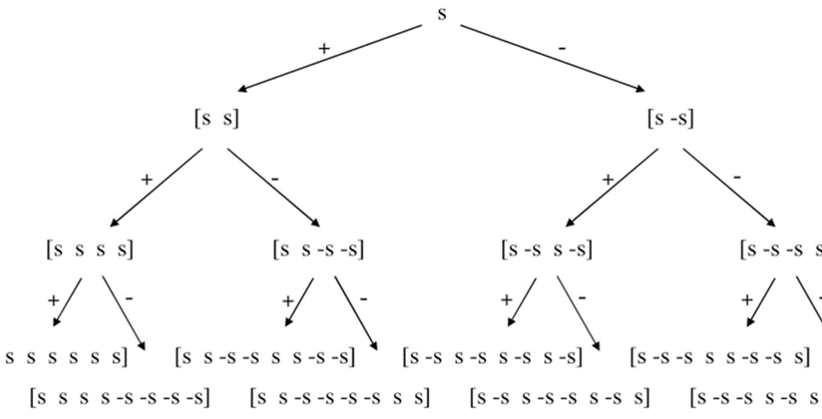
Binary tree

Slide 10
3D implementation
Here we have used a 3D implementation of the GCK which is useful to track spatio-temporal variations. In particular, the filters are divided in 3 types:
Spatial filters: no changes along the z axis
Temporal filters: changes only on the z axis
Spatio-temporal filters: changes along all three axes
Nota a piè di pagina

Slide 11
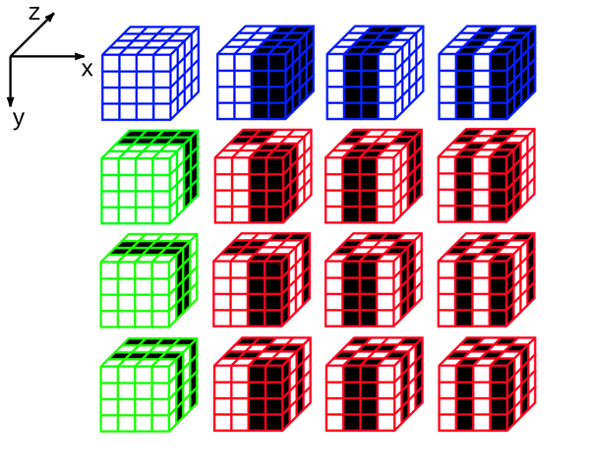
3D implementation
Spatial filters: no changes along the z axis (blue cubes)
Temporal filters: changes only on the z axis (green cubes)
Spatio-temporal filters: changes along all three axes (red cubes)
Nota a piè di pagina

Slide 12
Workflow
The main part was to extract the projections from the video, then an optical flow procedure is applied to a series of projections of the same type; in particular, I’ve chosen the middle one of the entire 3D block along the Z axis, since it is the most representative one of the variation of the movement.

Slide 13
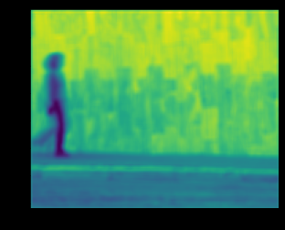
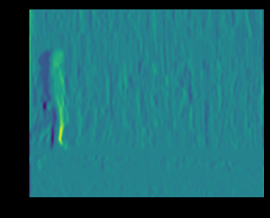
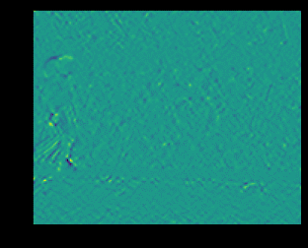
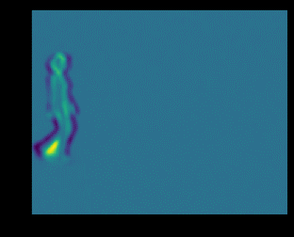
Projections

Slide 14
Workflow
Two matching procedure have been applied: a Lucas-Kanade optical flow also called “sparse” and a dense optical flow with the Farneback method.
Lucas-Kanade method computes optical flow for a sparse feature set (corners detected using Shi-Tomasi algorithm) while the Farneback method computes the optical flow for all the points in the frame. It is based on Gunner Farneback’s algorithm which is explained in “Two-Frame Motion Estimation Based on Polynomial Expansion” by Gunner Farneback in 2003.

Slide 15
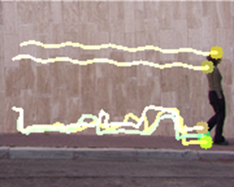
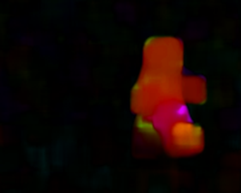
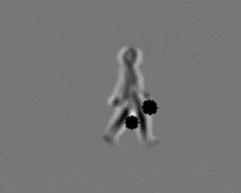
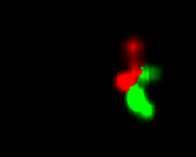
Results

